Slide 1
ASP.NET MVC
Notes:
The name stands for Active Server Pages Network Enabled Technologies.

Slide 2
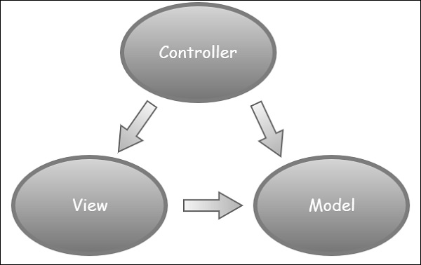
MVC Architectural Pattern
Its web development framework combines the features of MVC (Model-View-Controller) architecture
Designed in 1970s
Widely adopted in Web
ASP.NET MVC, Ruby on rails, Express
Notes:
The name stands for Active Server Pages Network Enabled Technologies.

Slide 3
MVC Architectural Pattern
The Model − A set of classes that describes the data you are working with as well as the business logic.
For example
Domain Model for a movie rental app
Movie
Customer
Rental
Transaction
These classes have properties and methods that purely represent the application state and rules and not tied to UI that means we can use these classes and use them in different app like desktop or mobile app
Notes:
The name stands for Active Server Pages Network Enabled Technologies.

Slide 4
MVC Architectural Pattern
The View − Defines how the application’s UI will be displayed. It is a pure HTML, which decides how the UI is going to look like.
The Controller − A set of classes that handles communication from the user or handling the HTTP request.
For example:
Imagine our application is hosted on vidly.com
When we send a request http://vidly.com/movies A controller will be selected to handle this request, this controller will collect all the movies from the database and put them in the view and return the view to the client or browser.
View
Controller
Model
Notes:
Each component have separate of concerns

Slide 5
MVC Architectural Pattern
Another thing with MVC is Router
Router
Selects the right controller to handle a request
A router based on some rules know that the request for vidly.com/movies should be handled by class called movies controller.
In ASP.NET methods are known as Actions.

Slide 6
Action Results in Controller
Action | Helper Method
ViewResult | View()
PartialViewResult | PartialView()
ContentResult | Content()
RedirectResult | Redirect()
RedirectToRouteResult | RedirectToAction()
JsonResult | Json()
FileResult | File()
HttpNotFoundResult | NoFound()
EmptyResult
Notes:
Content Result - for simple text
Redirect result – to redirect user to url
Json – json objects
Httpsnotfound 404 error
Empty result – voids

Slide 7
Scaffolding
In the context of ASP.NET MVC (Model-View-Controller), scaffolding refers to an automated code generation technique that helps developers quickly create the basic structure of a web application, including models, views, and controllers. Scaffolding can significantly speed up the development process by providing a starting point for common CRUD (Create, Read, Update, Delete) operations.
ASP.NET MVC scaffolding is often used with Entity Framework, a data access technology in ASP.NET, to generate code for interacting with a database. The scaffolding process involves creating the necessary files and code for basic CRUD operations based on a data model.
Here are the main components of scaffolding in ASP.NET MVC:
Models: Scaffolding generates model classes that represent entities in your data model. These classes typically map to tables in a database.
Views: Scaffolding generates views (HTML templates) that allow users to interact with the application. Views are created for listing items, displaying details, creating new items, editing existing items, and deleting items.
Controllers: Scaffolding generates controllers that handle HTTP requests, interact with the model to retrieve or update data, and pass data to the views. Controllers are responsible for handling user input and managing the flow of the application.
Notes:
The automatic creation of these files and file updates is known as scaffolding.

